Slide 1
OPERATING SYSTEMS (CS F372) Mass Storage
Barsha Mitra
CSIS Dept., BITS Pilani, Hyderabad Campus

Slide 2
Magnetic Disks

Slide 3
Mass Storage Structure
Magnetic disks provide bulk of secondary storage of modern computers
Disk in use rotates at 60 to 250 times per second (RPM)
Transfer rate is rate at which data flow between drive and computer
Positioning time (random-access time) is time to move disk arm to desired cylinder (seek time) and time for desired sector to rotate under the disk head (rotational latency)
Head crash results from disk head making contact with the disk surface
Disks can be removable
Disk drive is attached to computer via I/O bus
Buses vary, including ATA, SATA, USB, Fibre Channel (FC), etc.

Slide 4
Disk Structure
Disk drives are addressed as large 1-dimensional arrays of logical blocks
logical block is the smallest unit of transfer
The 1-dimensional array of logical blocks is mapped into the sectors of the disk sequentially
Sector 0 is the first sector of the first track on the outermost cylinder
Mapping proceeds in order through that track, then the rest of the tracks in that cylinder, and then through the rest of the cylinders from outermost to innermost
Physical Address – cylinder number, track number, sector number

Slide 5
Disk Scheduling
Minimize seek time
Disk bandwidth - total no. of bytes transferred divided by the total time between the first request for service and the completion of the last transfer
OS maintains queue of I/O requests, per disk or device
Idle disk can immediately work on I/O request, busy disk means request must be queued

Slide 6
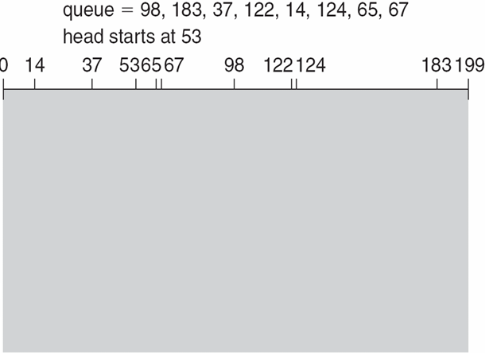
FCFS
Total head movement of 640 cylinders

Slide 7
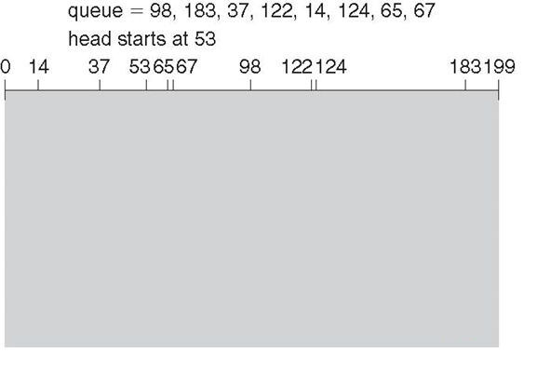
SSTF
Total head movement of 236 cylinders
Shortest Seek Time First selects the request with the minimum seek time from the current head position
May cause starvation of some requests

Slide 8
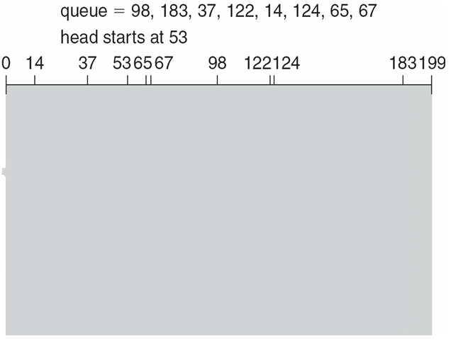
SCAN
ELEVATOR Algorithm
236 cylinders

Slide 9
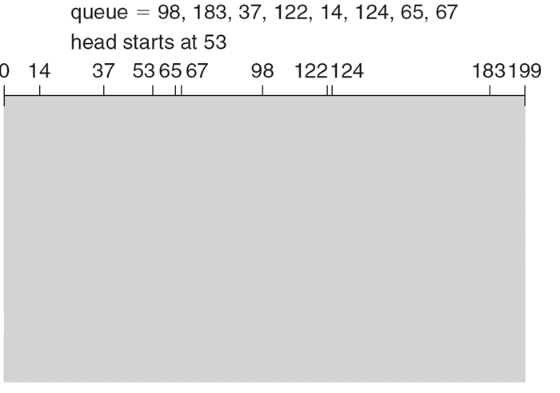
C-SCAN

Slide 10
Disk Management
To use a disk to hold files, the operating system still needs to record its own data structures on the disk
Partition the disk into one or more groups of cylinders, each treated as a logical disk
Logical formatting- creation of a file system, OS stores the initial file system data structures on the disk, data structures include maps of free and allocated space and an initial empty directory

Slide 11
RAID
RAID – redundant arrays of independent disks
multiple disk drives provides reliability via redundancy
Increases the mean time to failure
Mean time to repair – avg. time to replace a failed disk and restore the data on it
Mirrored Disk (volume)
Data Stripping – bit-level stripping, byte-level stripping, block-level stripping
RAID 0
RAID 1
RAID 2
RAID 3
RAID 4
RAID 5
RAID 6
HDD RAID vs SSD RAID
https://helpdeskgeek.com/reviews/hdd-raid-vs-ssd-raid-the-major-differences-you-should-know/

Slide 12
RAID 0
Level 0: Non redundant
Data striping is used for increased performance but no redundant information is maintained.
Striping is done at block level but without any redundancy.
Writing performance is best in this level because due to absence of redundant information there is no need to update redundant information

Slide 13
RAID 1
Level 1: Mirrored Same data is copied on two different disks. This type of redundancy is called mirroring. It is the most expensive system. Because two copies of same data are available in two different disks, it allows parallel read

Slide 14
RAID 2
Level 2: Error correcting codes This level uses bit-level data stripping in place of block level. It is used with drives with no built in error detection technique. Error-correcting codes (ECC) store two or more extra bits and it is used for reconstruction of the data if a single bit is damaged.

Slide 15
RAID 3
Level 3: Bit-Interleaved parity Data stripping is used and a single parity bit is used for error correction as well as for detection. Systems have disk controller that detects which disk has failed. RAID level 3 has a single check disk with parity bit.

Slide 16
RAID 4
Level 4: Block-Interleaved parity RAID level 4 is similar as RAID level 3 but it has Block-Interleaved parity instead of bit parity. You can access data independently so read performance is high.

Slide 17
RAID 5
Level 5: Block-Interleaved distributed parity RAID level 5 distributes the parity block and data on all disks. For each block, one of the disks stores the parity and the others store data. RAID level 5 gives best performance for large read and write.

Slide 18
RAID 6
Level 6: P+Q Redundancy Scheme What happens if more than one disk fails at a time? This level stores extra redundant information to save the data against multiple disk failures. It uses Reed-Solomon codes (ECC) for data recovery. Two different algorithms are employed

Slide 19
Thank You

